Slide 1
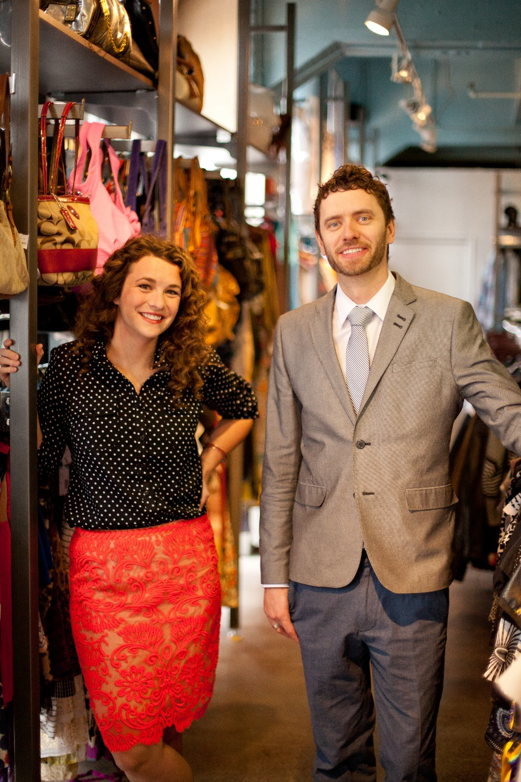
Chapter 15
Franchising
Bruce R. Barringer
R. Duane Ireland
Copyright ©2016 Pearson Education, Inc.
15-<number>

Slide 2
Chapter Objectives
1 of 2
Explain franchising and how this form of business ownership works.
Describe steps entrepreneurs can take to establish a franchise system.
Become familiar with the advantages and disadvantages of establishing a franchise system.
Describe actions and issues associated with the decision to buy a franchise.
Copyright ©2016 Pearson Education, Inc.
15-<number>

Slide 3
Chapter Objectives
2 of 2
5. Explain the steps an entrepreneur goes through to buy a franchise.
6. Identify and explain the various legal aspects associated with the franchise relationship.
7. Discuss two additional issues—franchise ethics and international franchising—entrepreneurs should think about when considering franchising.
Copyright ©2016 Pearson Education, Inc.
15-<number>

Slide 4
What is Franchising?
Franchising
  Franchising is a form of business organization in which a firm that already has a successful product or service (franchisor) licenses its trademark and method of doing business to another business or individual (franchisee) in exchange for a franchise fee and an ongoing royalty payment.
  Some franchisors are established firms (like McDonald’s) while others are first-time enterprises being launched by entrepreneurs (like Uptown Cheapskate).
Copyright ©2016 Pearson Education, Inc.
15-<number>

Slide 5
Two Types of Franchise Systems
1 of 2
Product and Trademark Franchise
  An arrangement under which the franchisor grants to the franchisee the right to buy its products and use its trade name.
  This approach typically connects a single manufacturer with a network of dealers or distributors.
    For example, General Motors has established a network of dealers that sell GM cars and use the GM trademark in their advertising and promotions.
    Other examples of product and trademark franchisors include agricultural machinery dealers, soft drink bottlers, and beer distributorships.
Copyright ©2016 Pearson Education, Inc.
15-<number>

Slide 6
Two Types of Franchise Systems
2 of 2
Business Format Franchise
  An arrangement under which the franchisor provides a formula for doing business to the franchisee along with training, advertising, and other forms of assistance.
  Fast-food restaurants, convenience stores, and motels are well-known examples of business format franchises.
    Business format franchises are by far the most popular form of franchising, particularly for entrepreneurial firms.
Copyright ©2016 Pearson Education, Inc.
15-<number>

Slide 7
10 Industries In Which Business Format Franchises Predominate
Automotive
Business Services
Commercial and Residential Services
Lodging
Personal Services
Quick Service Restaurants
Real Estate
Retail Food
Retail Products & Services
Table/Full-Service Restaurants
Copyright ©2016 Pearson Education, Inc.
15-<number>

Slide 8
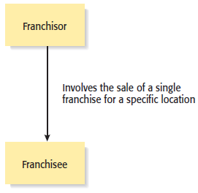
Types of Franchise Agreements
1 of 3
Individual Franchise Agreement
Copyright ©2016 Pearson Education, Inc.
15-<number>

Slide 9
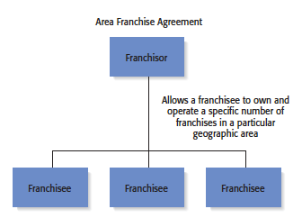
Types of Franchise Agreements
2 of 3
Area Franchise Agreement
Copyright ©2016 Pearson Education, Inc.
15-<number>

Slide 10
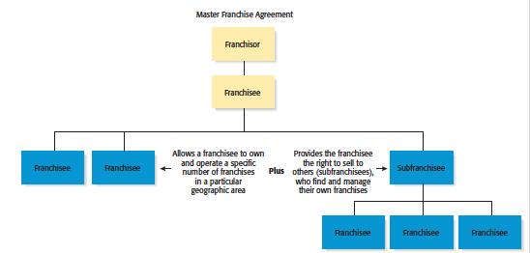
Types of Franchise Agreements
3 of 3
Master Franchise Agreement
Copyright ©2016 Pearson Education, Inc.
15-<number>

Slide 11
When to Franchise?
When Is Franchising Most Appropriate?
  Franchising is most appropriate when a firm has a strong or potentially strong trademark, a well-designed business method, and a desire to grow.
  In some instances franchising is not appropriate.
    For example, franchising works for Burger King but would not work for Walmart.
    Each individual Burger King store is relatively small and policies and procedures can be written for almost any contingency.
    In contrast, Walmart stores are much larger, more expensive to build, and more complex to run compared to Burger King. It would be nearly impossible for Walmart to find enough franchisees with the financial capital and expertise to run its more than 11,000 stores.
Copyright ©2016 Pearson Education, Inc.
15-<number>

Slide 12
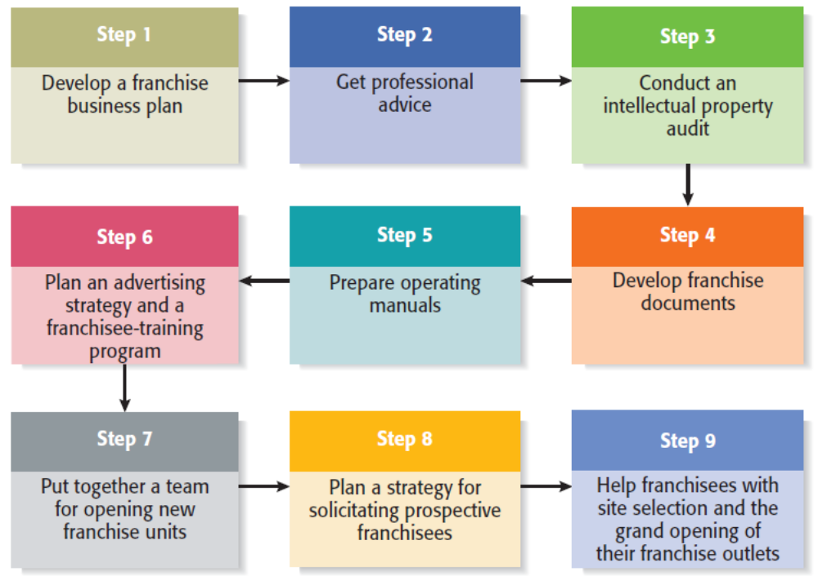
Nine Steps in Setting Up a Franchise System
Copyright ©2016 Pearson Education, Inc.
15-<number>

Slide 13
Qualities to Look for in
Prospective Franchisees
Good work ethic.
Ability to follow instructions.
Ability to operate with minimal supervision.
Team oriented.
Experience in the industry in which the franchise competes.
Adequate financial resources and good credit history.
Ability to make suggestions without becoming confrontational
or upset if the suggestions are not adopted.
Represents the franchisor in a positive manner.
Copyright ©2016 Pearson Education, Inc.
15-<number>

Slide 14
Ways Franchisors Can Develop the Potential of Their Franchisees
Provide mentoring that supersedes routine training.
Keep operating manuals up-to-date.
Keep products, services, and business systems up to date.
Solicit input from franchisees to reinforce their importance in
the larger system.
Encourage franchisees to develop a franchise association.
Maintain the franchise system’s integrity.
Copyright ©2016 Pearson Education, Inc.
15-<number>

Slide 15
Advantages and Disadvantages of Franchising as a Method of Business Expansion
Advantages
Disadvantages
Rapid, low-cost market expansion.
Income from franchise fees and
royalties.
Franchisee motivation.
Access to ideas and suggestions.
Cost savings.
Increased buying power.
Profit sharing.
Loss of control.
Friction with franchisees.
Managing growth.
Differences in required business skills.
Legal expenses.
Copyright ©2016 Pearson Education, Inc.
15-<number>

Slide 16
Buying a Franchise
From the Franchisee’s Point of View
1 of 3
Buying a Franchise
  Purchasing a franchise is an important business decision involving a substantial financial commitment.
  Potential franchise owners should strive to be as well informed as possible before purchasing a franchise and should be aware that it is often legally and financially difficult to exit a franchise relationship.
Copyright ©2016 Pearson Education, Inc.
15-<number>

Slide 17
Buying a Franchise
2 of 3
Answering the following questions will help determine if franchising is right for you
Are you willing to take orders? Franchises are typically
very particular about how outlets operate.
Are you willing to be part of a franchise “system” rather
than be an independent businessperson?
How will you react if you make a suggestion to your
franchisor and your suggestion is rejected?
What are you looking for in a business? How hard do you
want to work?
Copyright ©2016 Pearson Education, Inc.
15-<number>

Slide 18
Buying a Franchise
3 of 3
Answering the following questions will help determine if franchising is right for you
How willing are you to put your money at risk? How will
you feel if your business is operating at a net loss but you
will have to pay royalties on your gross income?
Copyright ©2016 Pearson Education, Inc.
15-<number>

Slide 19
The Costs Involved With Buying a Franchise
1 of 3
Initial Franchise Fee
  The initial fee varies depending on the franchisor.
Capital Requirements
  The costs vary but may include the cost of buying real estate, the cost of putting up a building, the purchase of inventory, and the cost of obtaining a business license.
Continuing Royalty Payment
  Is usually around 5% of monthly gross income.
Copyright ©2016 Pearson Education, Inc.
15-<number>

Slide 20
The Costs Involved With Buying a Franchise
2 of 3
Advertising Fees
  Franchisees are often required to pay into a national or regional advertising fund.
Other Fees
  Other fees may be charged for various activities, including:
    Training additional staff.
    Providing management expertise when needed.
    Providing computer assistance.
    Providing a host of other items or support services.
Copyright ©2016 Pearson Education, Inc.
15-<number>

Slide 21
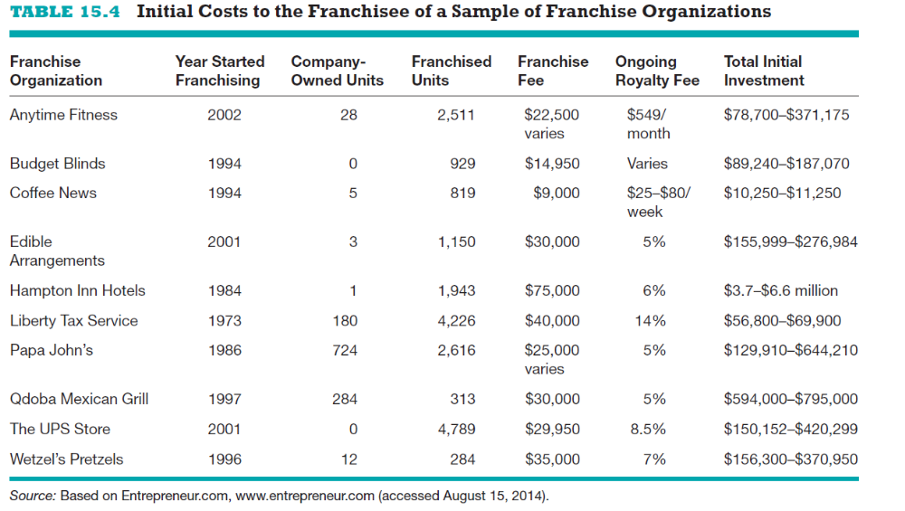
The Costs Involved With Buying a Franchise
3 of 3
Copyright ©2016 Pearson Education, Inc.
15-<number>

Slide 22
Advantages and Disadvantages of
Buying a Franchise
Advantages
Disadvantages
A proven product or service within
an established market.
An established trademark or
business system.
Franchisor’s training, technical
expertise, and managerial expertise.
An established marketing network.
Franchisor ongoing support.
Availability of financing.
Potential for business growth.
Cost of the franchise.
Restrictions on creativity.
Duration and nature of the commitment.
Risk of fraud, misunderstandings, or
lack of franchisor commitment.
Problems of termination or transfer.
Poor performance on the part of other
franchisees.
Potential for failure.
Copyright ©2016 Pearson Education, Inc.
15-<number>

Slide 23
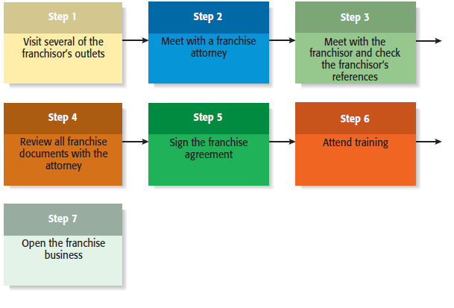
Seven Steps in Purchasing a Franchise
Copyright ©2016 Pearson Education, Inc.
15-<number>

Slide 24
Watch Out! Common Misconceptions About Franchising
Franchising is a safe investment.
A strong industry ensures franchise success.
A franchise is a “proven” business system.
There is no need to hire a franchise attorney or an accountant.
The best systems grow rapidly and it is best to be part of a rapid-growth
system.
I can operate my franchise outlet for less than the franchisor predicts.
The franchisor is a nice person—he’ll help me out if I need it.
Copyright ©2016 Pearson Education, Inc.
15-<number>

Slide 25
Legal Aspects of the Franchise Relationship
Federal Rules and Regulations
  The offer and sale of a franchise are regulated at the federal level.
    According to Federal Trade Commission (FTC) rule 436, franchisors must furnish potential franchisees with written disclosures that provide information about the franchisor, the franchised business, and the franchise relationship.
    In most cases, the disclosures are made through a lengthy document referred to as the Franchisor Disclosure Document (FDD).
    The FDD contains 23 categories of information that give a prospective franchisee a broad base of information about the background and financial health of the franchisor.
Copyright ©2016 Pearson Education, Inc.
15-<number>

Slide 26
More About Franchising
1 of 2
Franchise Ethics
  The majority of franchisors and franchisees are highly ethical.
  There are certain features of franchising, however, that make it subject to ethical abuse. These features are as follows:
    The get-rich-quick mentality.
    The false assumption that buying a franchise is a guarantee of business success.
    Conflicts of interest between franchisors and franchisees.
Copyright ©2016 Pearson Education, Inc.
15-<number>

Slide 27
More About Franchising
2 of 2
International Franchising
  International opportunities for franchising are becoming more prevalent for the following two reasons:
    The markets for certain franchised products in the U.S. have become saturated (i.e., fast food).
    The trend toward globalization continues.
  Steps to take before buying a franchise overseas:
    Consider the value of the franchisor’s name in the foreign country.
    Get a good lawyer.
    Determine whether the product or service is saleable in the foreign country.
    Find out how much training and support you will receive from the franchisor.
Copyright ©2016 Pearson Education, Inc.
15-<number>

Slide 28

Copyright ©2016 Pearson Education, Inc.
15-<number>

